Slide 1
Lecture 15-16: Robotics

Slide 2
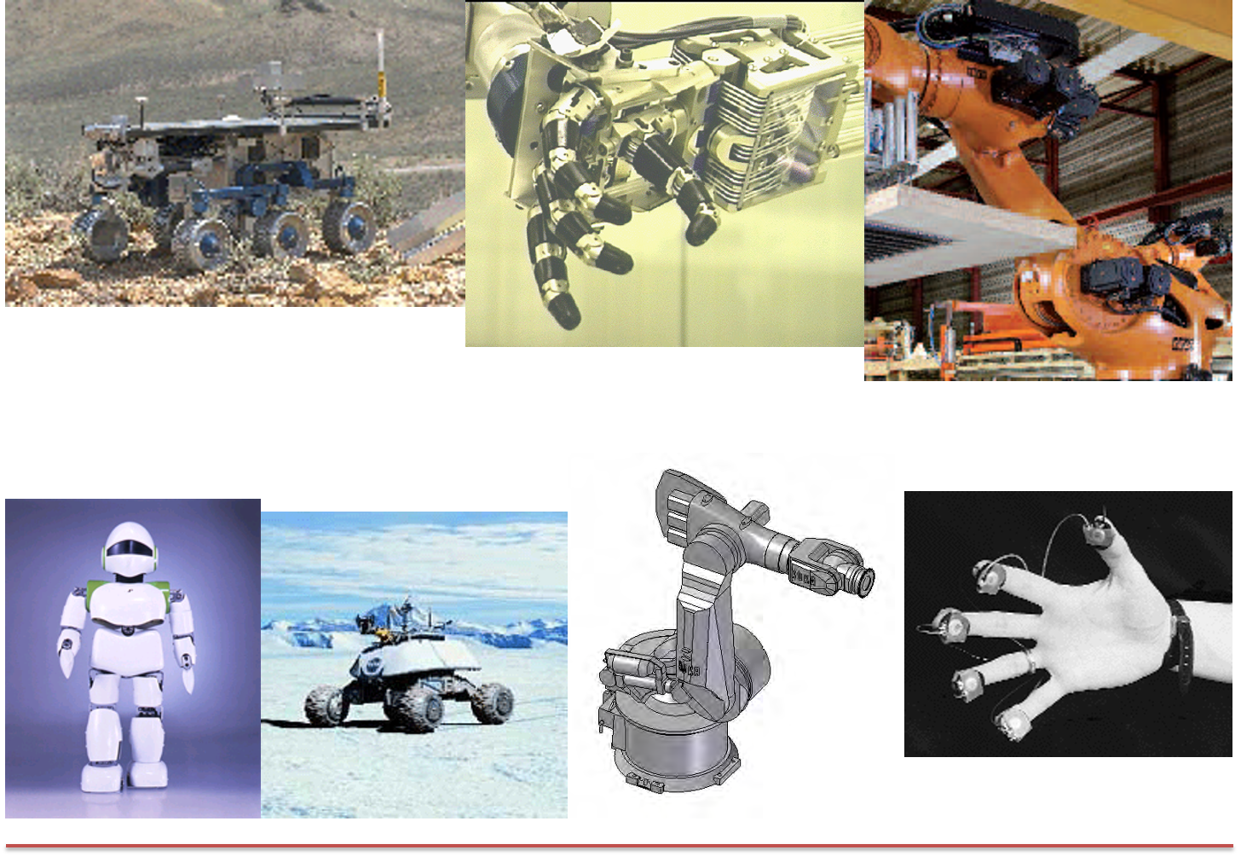
I. Introduction
Robotics is a field that deals with the design, construction, operation, and use of robots.
Use of mechanical, electrical, and computer engineering to create machines that can perform tasks independently or with minimal human intervention.
Robots have sensing, actuation, and processing capabilities.
Robot comes from the Czech word robota:
servitude, forced labor

Slide 3
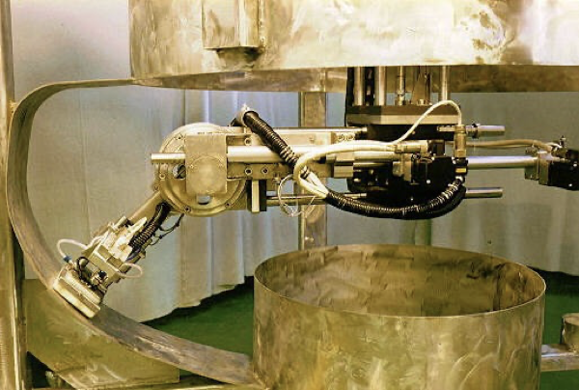
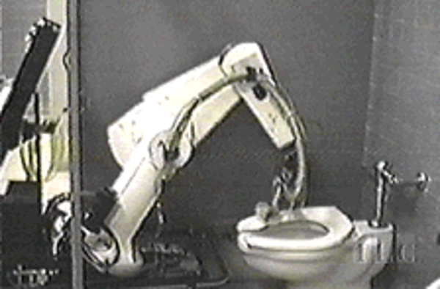
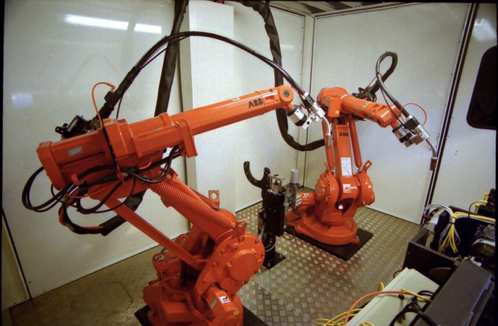
Why Robotics: 3 D’s of Robotization
Dirty
Roomba
Dull
Security Guard
Dangerous
Daksha
Anything else?

Slide 4
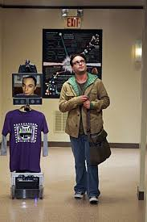
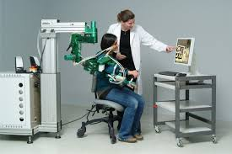
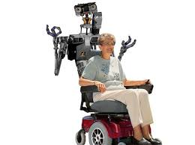
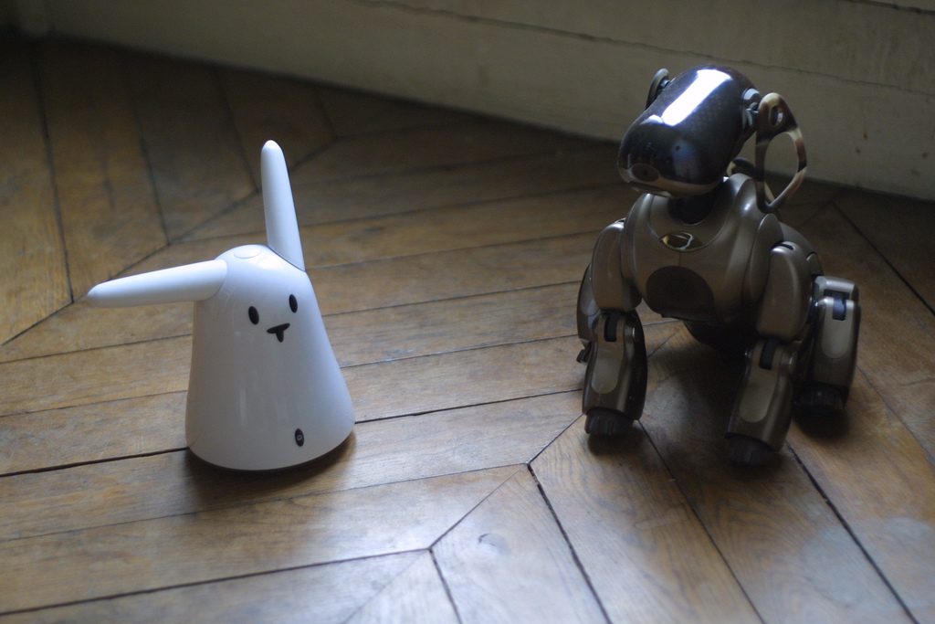
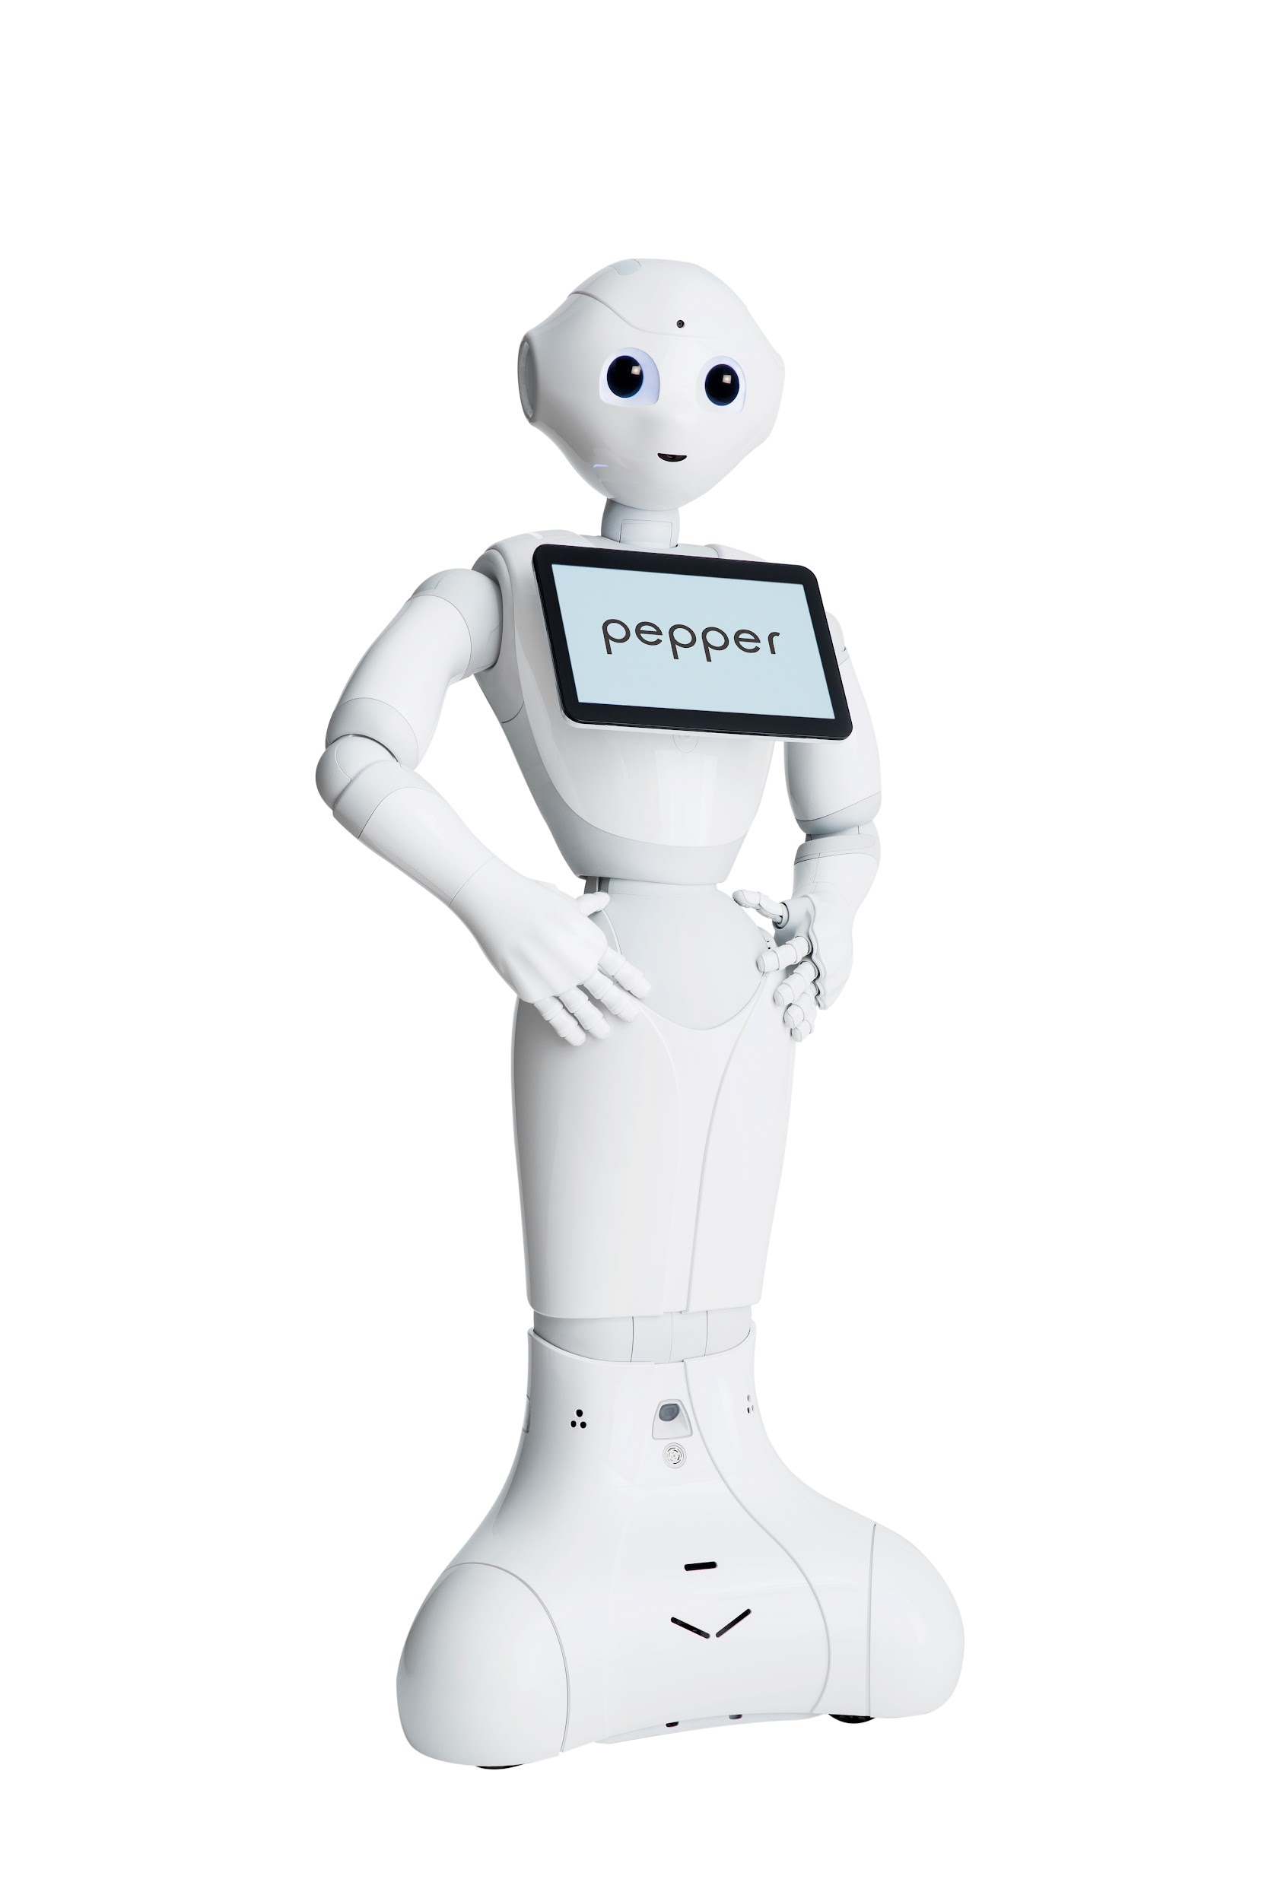
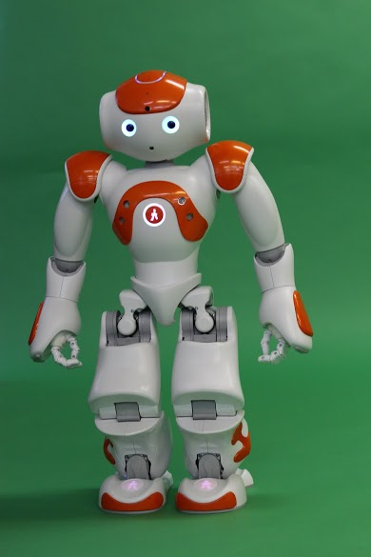
Beyond 3 D’s: Social Robots
“Robots that operate via social interaction”

Slide 5
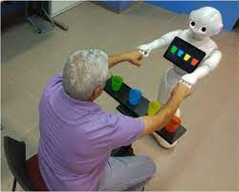
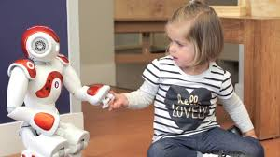
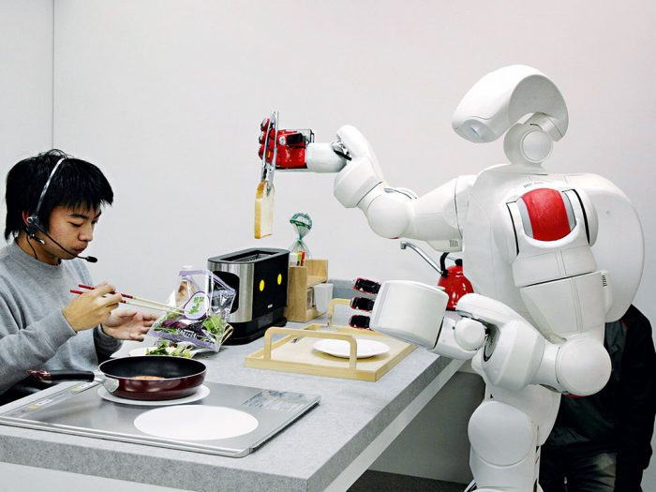
Motivation: Social Robotics
To achieve positive outcomes in diverse applications such as
Education
Health,
Entertainment,
Communication, and
Tasks requiring collaborative teamwork.

Slide 6
Components
Actuators: The parts that move the robot, such as motors and pistons.
Sensors: The parts that detect the environment, such as cameras, microphones, and touch sensors.
Controllers: The parts that process data and send commands to the actuators, such as microprocessors and microcontrollers.
End effectors: The parts that interact with the environment, such as grippers and cutting tools.
Power supply: The parts that provide energy to the robot, such as batteries and power cables.

Slide 7
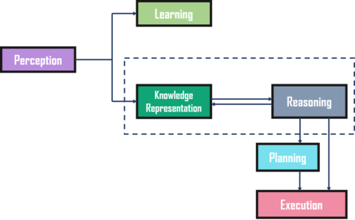
Components of an Intelligent System

Slide 8
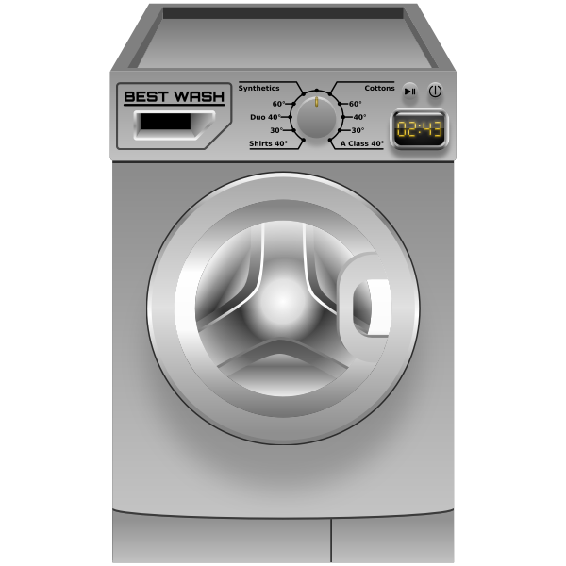
What is a Robot?
Is Washing Machine a robot?
A possible distinction is whether the workspace is physically inside or outside the device.
The cognitive ability required of a robot is much higher as the outside world is complex and harder to understand and control.
Appliances like washing machines may not be considered robots due to their limited workspace and lack of advanced cognitive abilities.
Self-driving cars and smartphones?

Slide 9
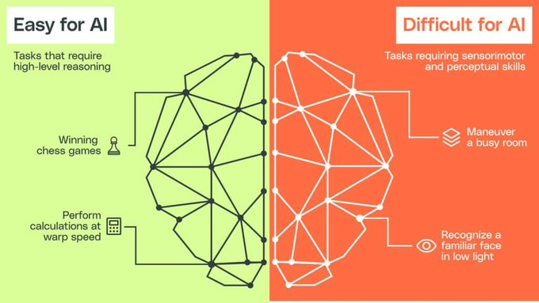
Moravec’s Paradox?
Contrary to traditional assumptions, reasoning requires very little computation, but sensorimotor and perception skills require enormous computational resources.

Slide 10
Moravec’s Paradox?
Hard Problems Are Easy, Easy Problems Are Hard!
Cultural vs. Biological Evolution:
Skills developed through cultural evolution (e.g., mathematics, logic, scientific reasoning) are easier to automate because they are based on explicit rules and frameworks.
Skills rooted in biological evolution (e.g., intuition, sensory perception) are harder to automate because they rely on implicit, subconscious processes.
Social and Emotional Intelligence:
Skills like empathy, understanding motivations, and social interaction are hard to engineer because they are deeply rooted in human evolution and are largely unconscious.
Implications for Automation:
Jobs requiring physical dexterity, creativity, or emotional intelligence (e.g., caregiving, art, teaching) are less likely to be fully automated in the near future.

Slide 11
Quiz 1

Slide 12
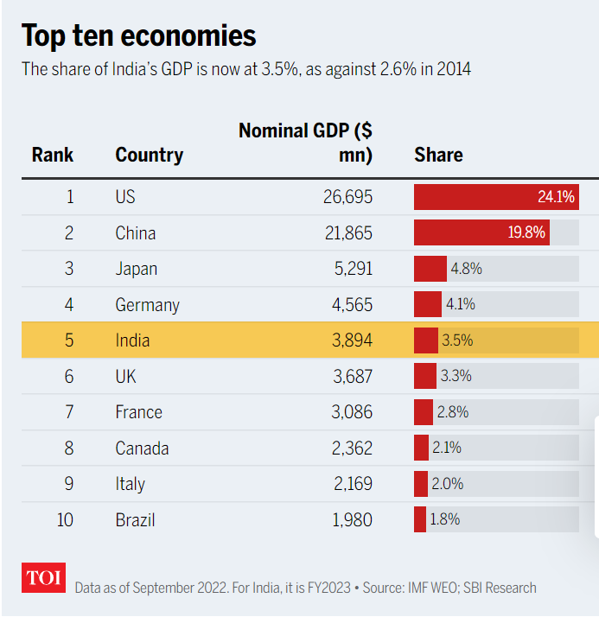
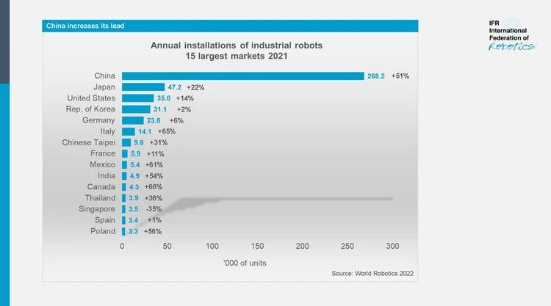
Significant Opportunities in Robotics!

Slide 13
Significant Opportunities in Robotics!
India's use of robotics is growing at 12 percent, almost twice that of the global rate.
There has been an increase of 191 percent in the number of job postings in the robotics sector in India between May 2015 and May 2020.
The density of robots in India is one of the lowest, 4 per 10,000 employees, compared to 154, 55.2, and 40.4 for China, Japan, and the USA, respectively, the top three economies of the world.

Slide 14
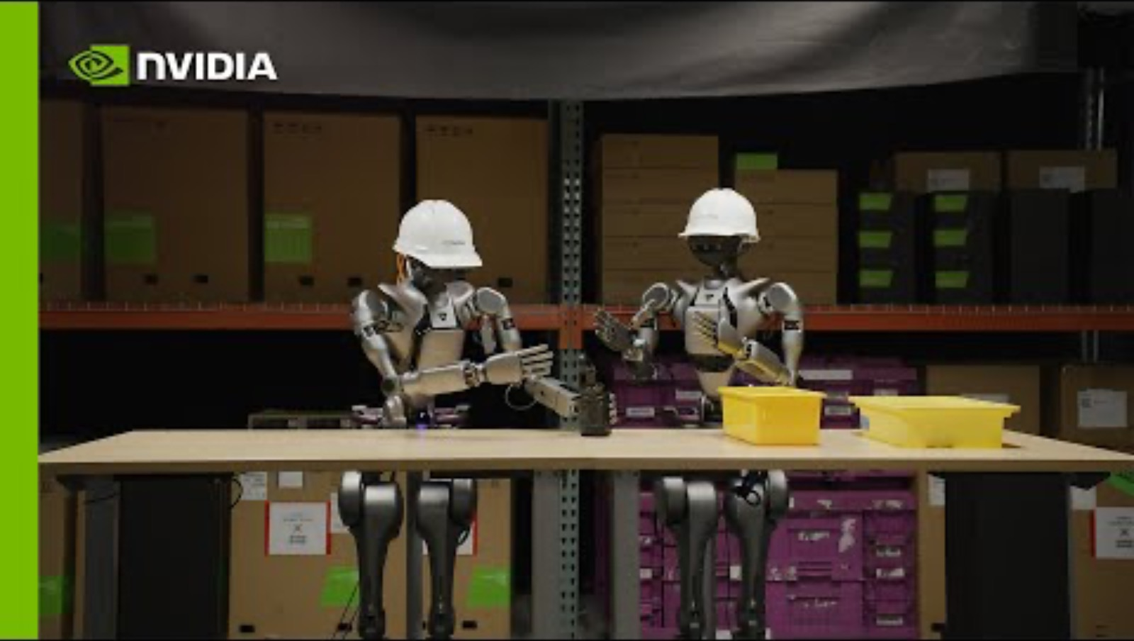
NVIDIA Isaac GR00T N1

Slide 15


Slide 16
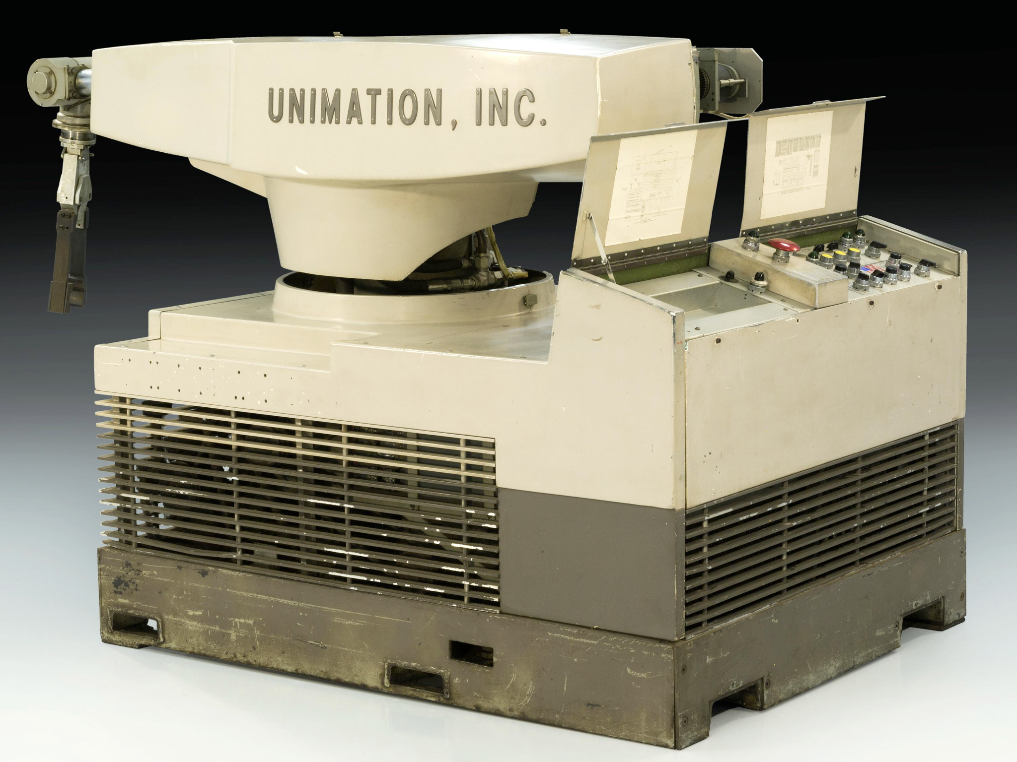
Brief History - I
Robotics has a long history, dating back to ancient times when the Greeks and Romans used simple mechanical devices to perform tasks.
1921 - The term "robot" was first used in 1920 in a play called "R.U.R." Or "Rossum's universal robots" by the Czech writer Karel Capek.
1940s and 1950s: Researchers began to explore the possibility of creating machines that could perform tasks autonomously. This led to the development of the first electronic computers, which were used to control industrial machinery.
In 1956, George Devol and Joseph Engelberger founded the first robotics company, Unimation, which introduced the first industrial robot in 1961.
Unimate, 1961

Slide 17
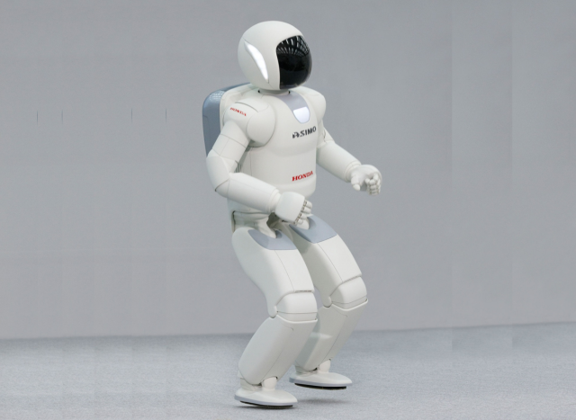
Brief History - II
The 1960s and 1970s saw significant growth in the robotics industry, with robots being used for welding, painting, and other manufacturing tasks.
In the 1980s, robots became more advanced and began to be used in new applications, such as surgery and space exploration.
The 1990s saw the development of humanoid robots, such as Honda's ASIMO, which could walk, climb stairs, and interact with humans.
In the 21st century, robots have become more integrated into society, with applications in areas such as education, agriculture, and service industries.
ASMIO, 1990

Slide 18
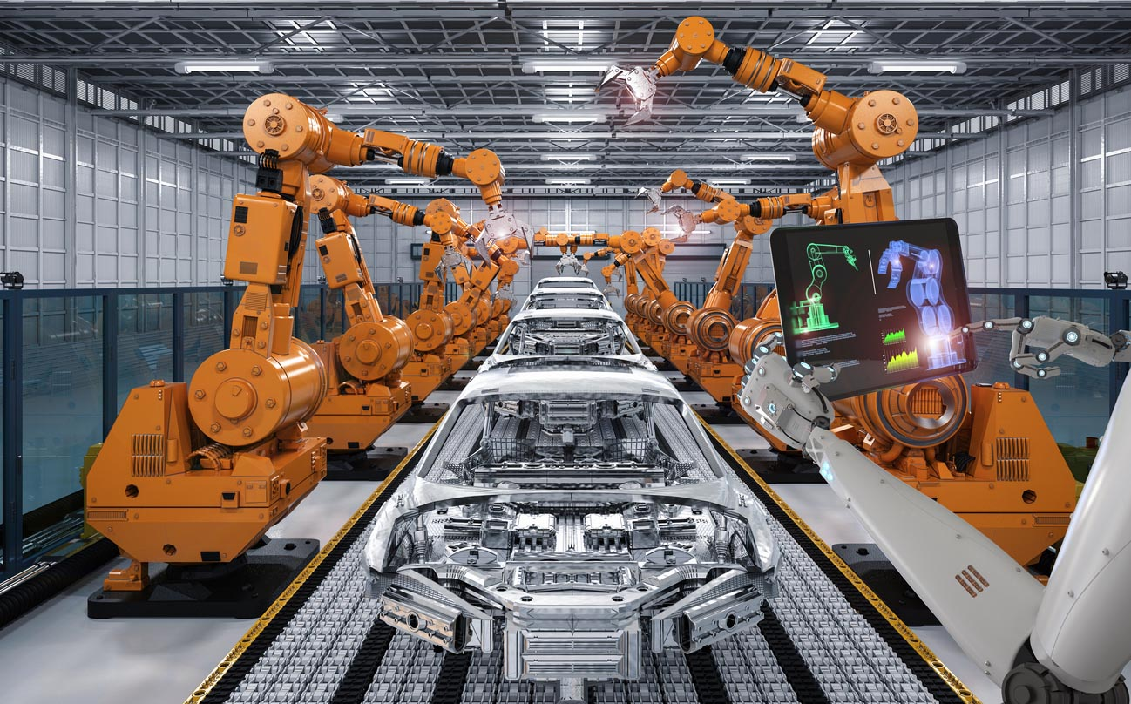
II. Types of Robots: Industrial robots
Used in manufacturing and assembly lines to perform repetitive tasks.
Examples include robotic arms that weld car parts or pick and place machines that move items from one place to another.
Can work faster and more accurately than humans.

Slide 19
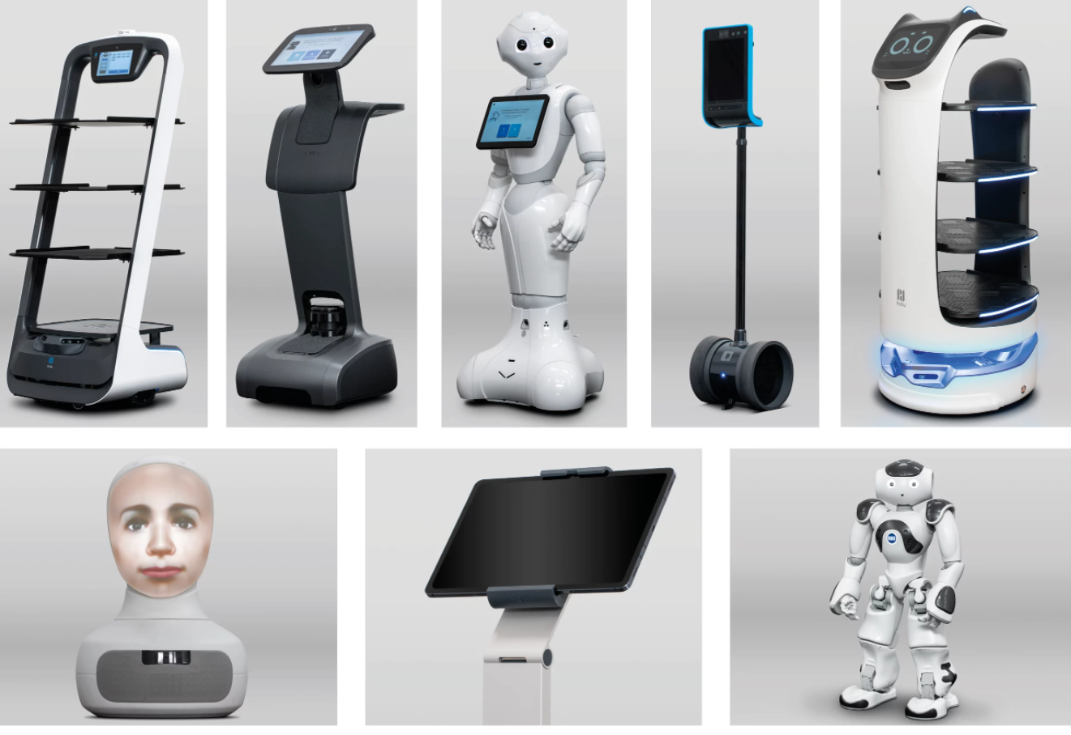
II. Types of Robots: Service robots
Used in industries such as healthcare, hospitality, and retail to perform tasks that are dangerous, repetitive, or difficult for humans.
Examples include robotic vacuum cleaners, robotic lawn mowers, and robotic waiters.
Can increase efficiency and reduce costs in various industries.

Slide 20
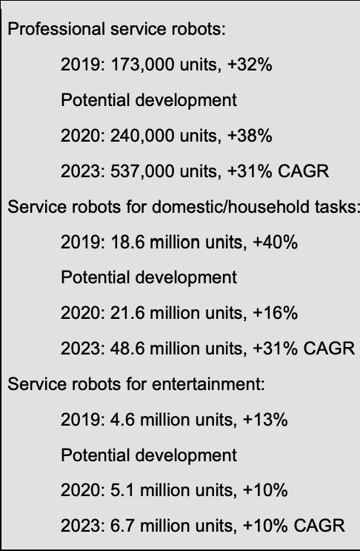
Service robots on the rise
Executive Summary: World Robotics 2020 Service Robots
https://ifr.org/img/worldrobotics/Executive_Summary_WR_2020_Service_Robots.pdf

Slide 21
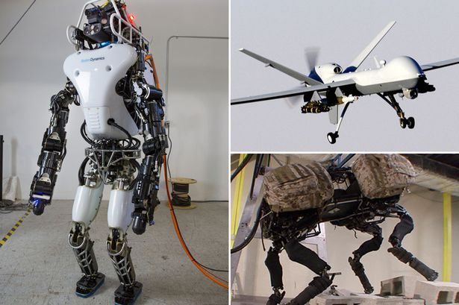
II. Types of Robots: Military robots
Used in the military for reconnaissance, surveillance, and combat operations.
Examples include unmanned aerial vehicles (UAVs), unmanned ground vehicles (UGVs), and bomb disposal robots.
Can reduce the risk to human life and provide greater situational awareness.

Slide 22
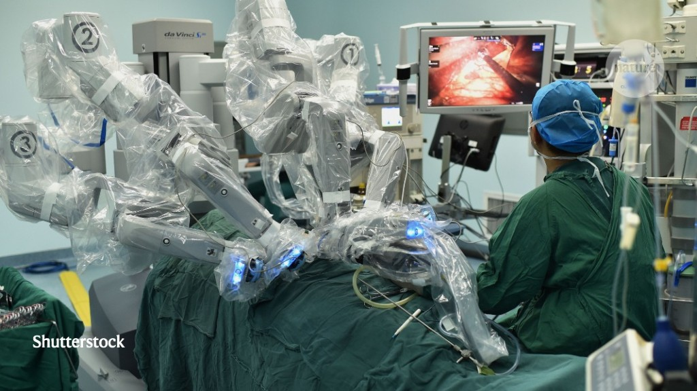
II. Types of Robots: Medical robots
Used in medical procedures to assist doctors and nurses in surgeries and treatments.
Examples include surgical robots, exoskeletons, and rehabilitation robots.
Can improve accuracy and reduce the recovery time for patients.

Slide 23
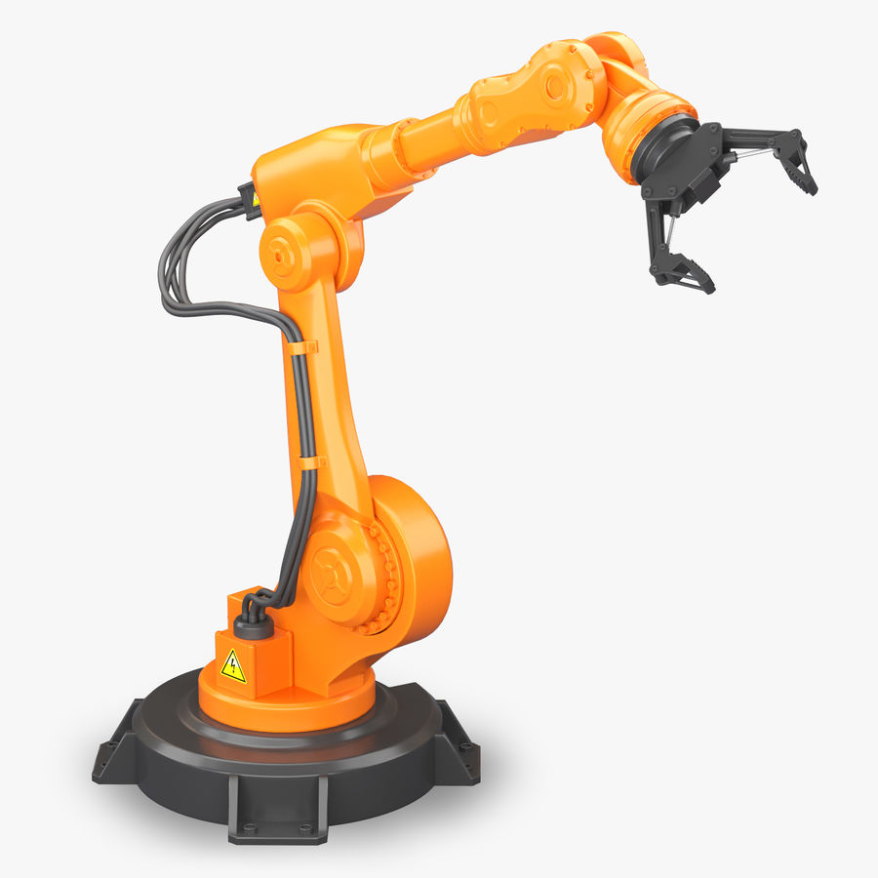
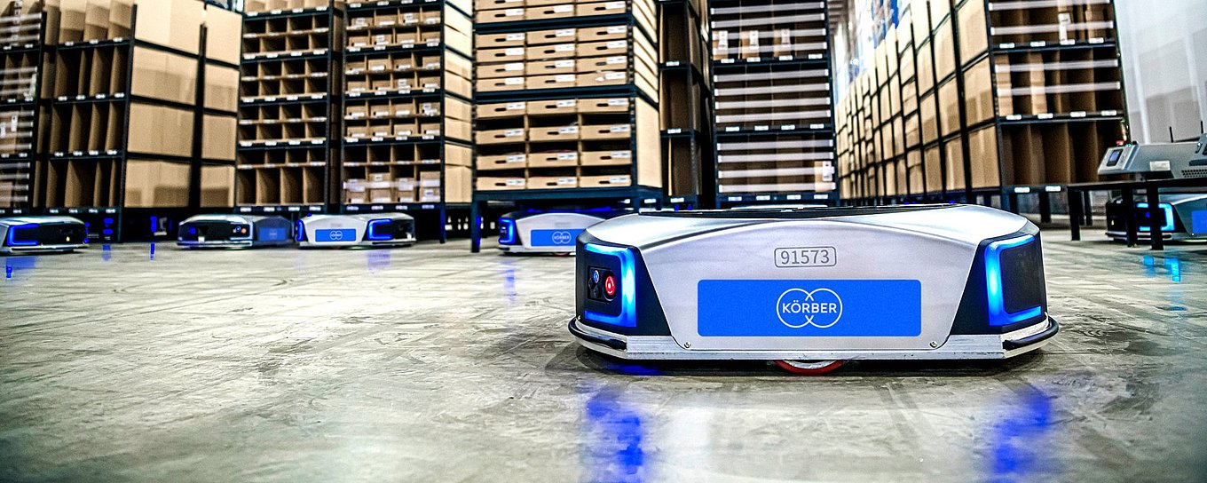
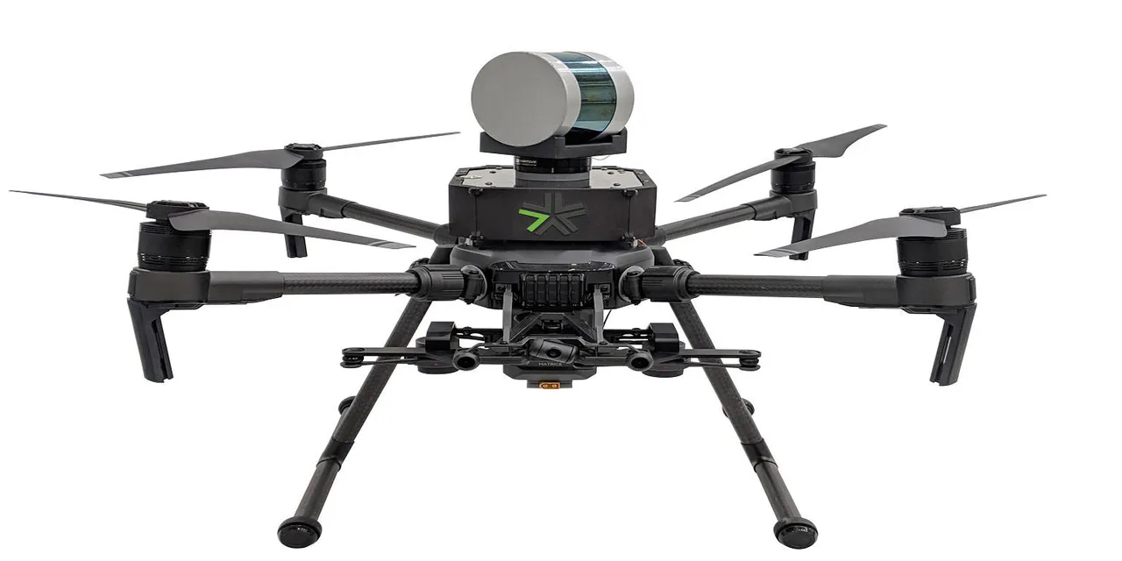
II. Types of Robots: Based on Mobility
Manipulator robots:
Stationary robots that manipulate objects using one or more robotic arms.
Examples include welding robots, pick-and-place robots, and 3D printing robots.
Mobile robots:
Robots that move around on wheels, tracks, or legs to perform tasks in various environments.
Examples include AGVs, drones, and self-driving cars.
UAVs (Unmanned Aerial Vehicles):
Robots that fly and perform tasks in the air.
Examples include quadcopters, fixed-wing UAVs, and hybrid VTOL UAVs.

Slide 24
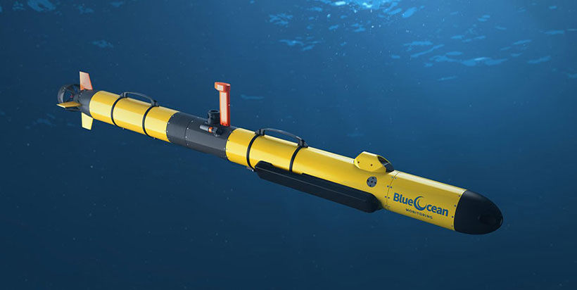
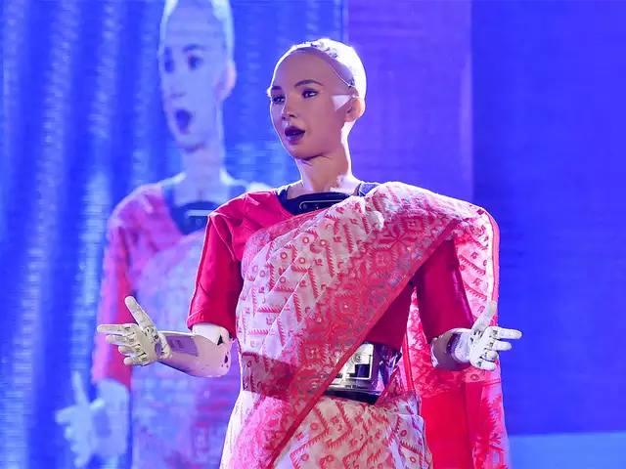
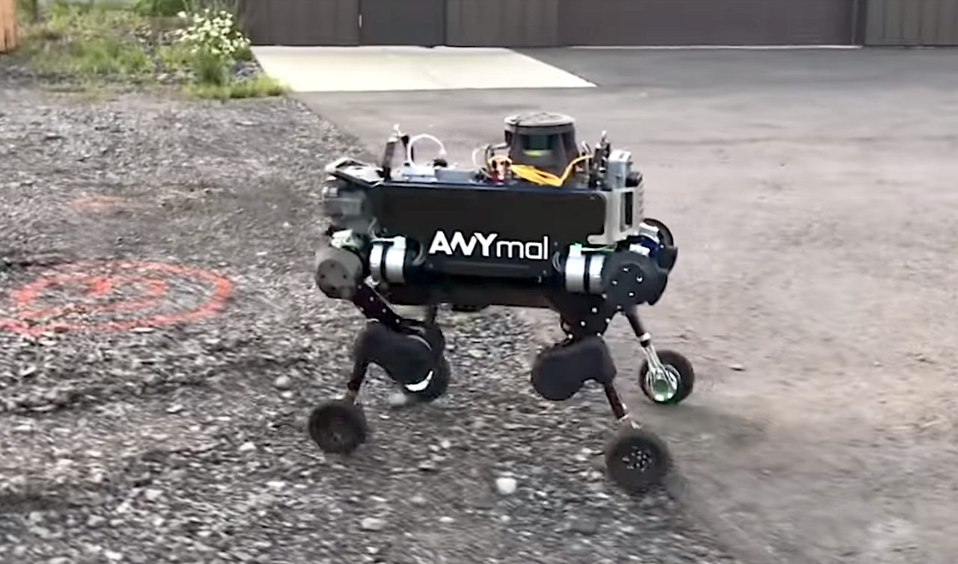
II. Types of Robots: Based on Mobility
Underwater robots:
Robots that move and perform tasks underwater.
Examples include ROVs, AUVs, and gliders.
Humanoid robots:
Robots that resemble and mimic human movements and behaviors.
Examples include ASIMO, Pepper, and Sophia.
Hybrid robots:
Robots that combine multiple modes of mobility to perform tasks in complex environments.
Examples include snake-like robots, wheeled robots with legs, and flying robots with arms.

Slide 25
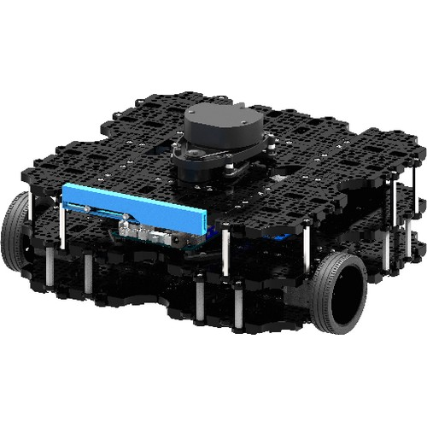
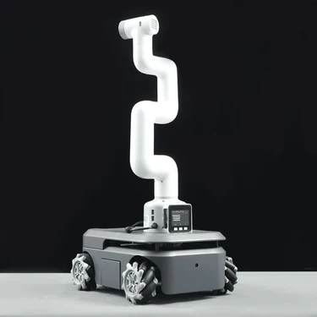
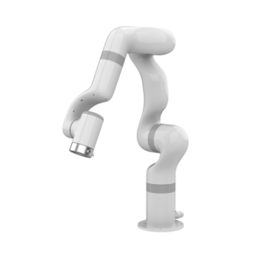
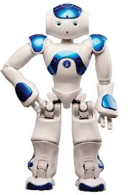
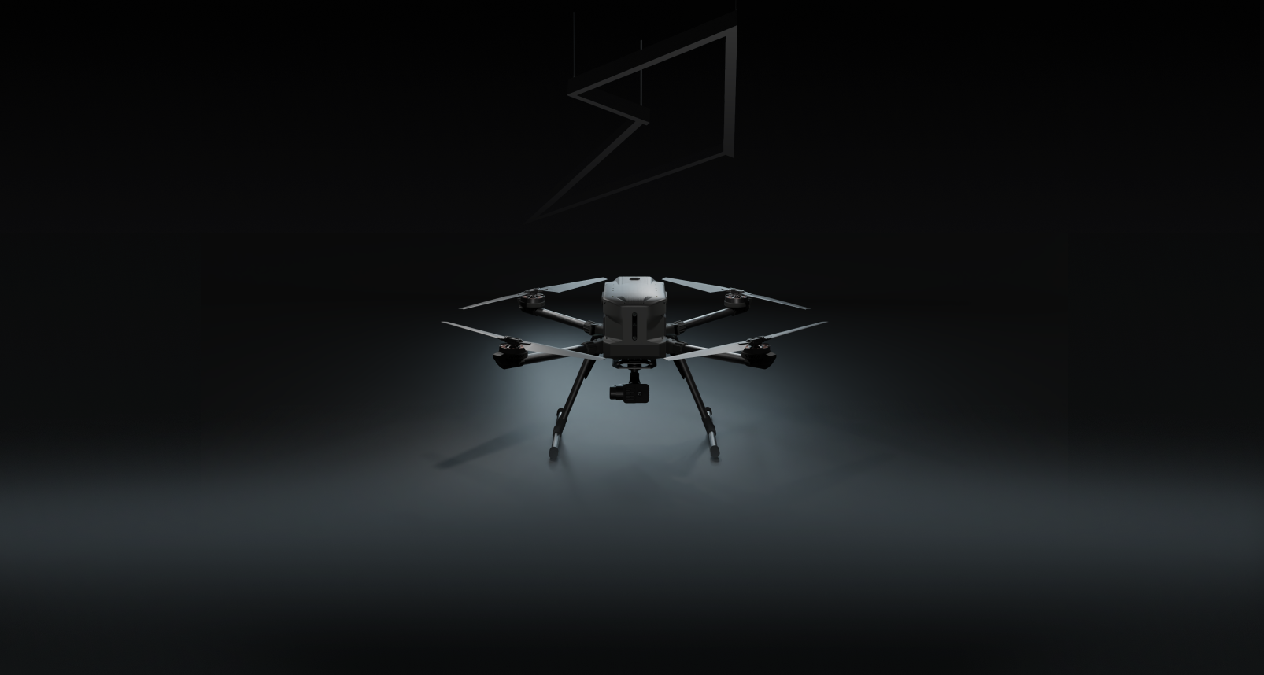
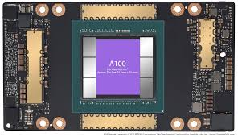
IRAS-HUB [B-419]
Turtlebot-3-waffle-pi
Smart Autonomous Navigation
Ufactory X-arm
NAO Robot
Vectros: ATHROS
NVIDIA A100 GPUs

Slide 26
Quiz 2

Slide 27
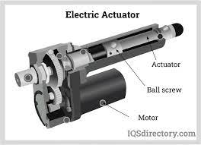
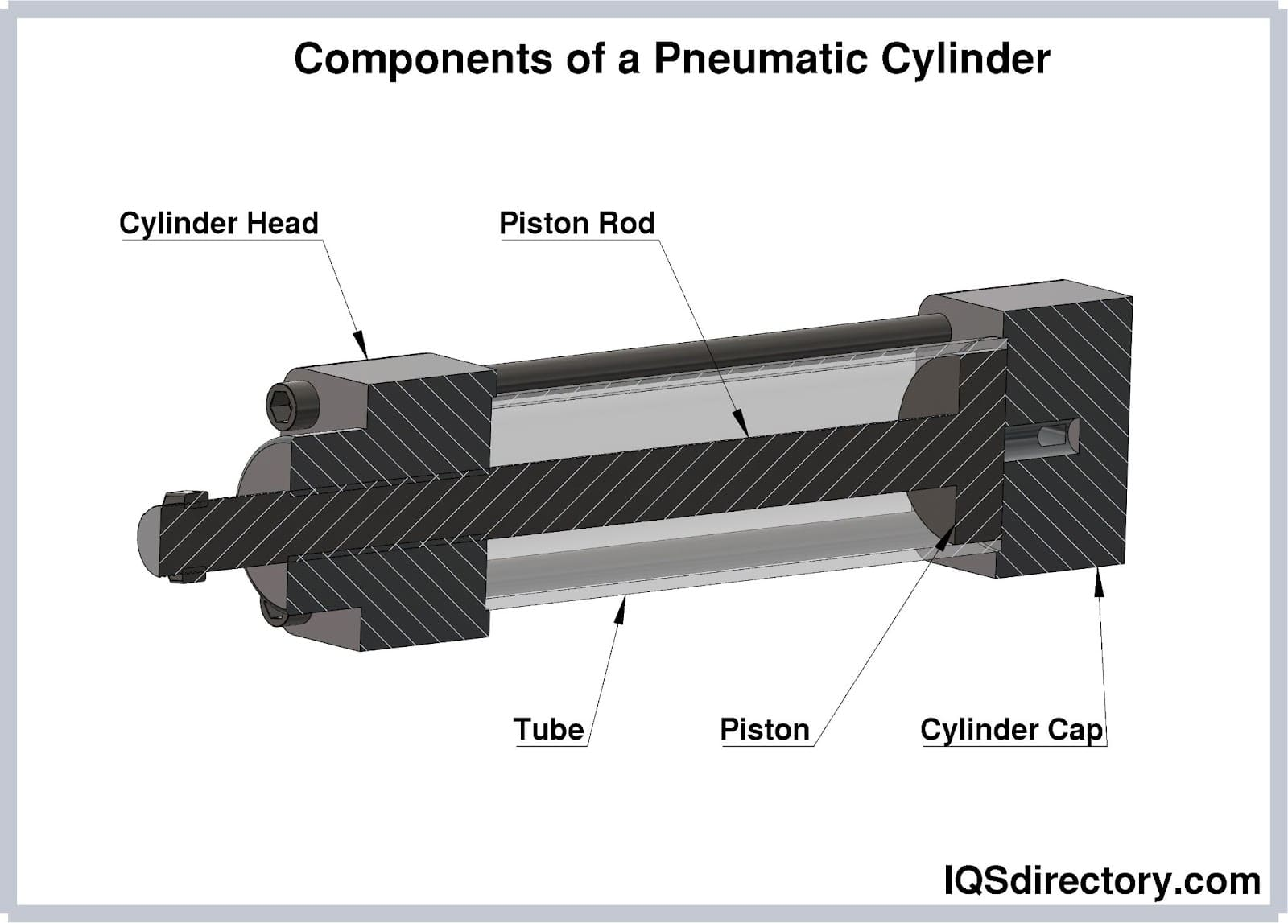
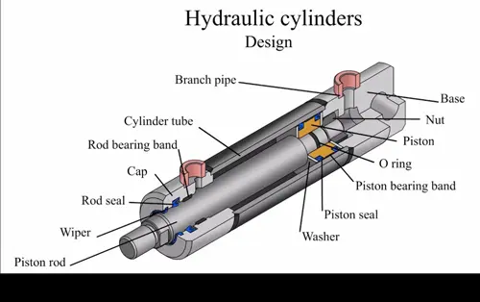
III. Components of a Robot: Actuators
Definition: devices that convert electrical or other types of energy into mechanical motion.
Linear motion or rotary motion
Three types based on the energy:
Electric: motors, servos,
Pneumatic: pneumatic cylinders, and
Hydraulic actuators
Function: move robot joints or end effectors to perform tasks

Slide 28
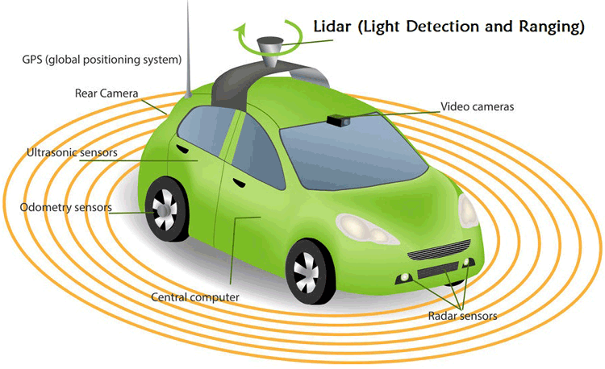
III. Components of a Robot: Sensors
Definition: devices that measure physical or environmental conditions and convert them into electrical signals
Examples: cameras, microphones, infrared sensors, tactile sensors
Function: provide feedback to the robot's control system for decision making and movement adjustments
Active Sensors: sensors that emit energy into the environment and measure the response
Examples: radar, sonar, lidar
Passive Sensors: sensors that detect the energy emitted or reflected by objects in the environment without actively emitting energy
Examples: cameras, infrared sensors, acoustic sensors

Slide 29
III. Active vs Passive Sensors
Feature | Active Sensors | Passive Sensors
Energy Emission | Emits energy (light, sound, radio waves) | Does not emit energy
Works in the Dark? | Yes (independent of light) | No (depends on ambient energy)
Range | Longer (since it emits its own signals) | Shorter (relies on natural sources)
Power Consumption | Higher (requires energy for emission) | Lower (only measures existing energy)
Interference Risk | Possible (e.g., LiDAR interference from fog, ultrasonic noise issues) | Minimal
Cost | Usually higher | Usually lower

Slide 30
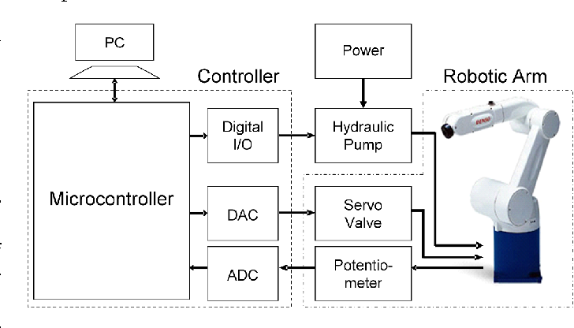
III. Components of a Robot: Controllers
Definition: the "brain" of the robot that processes sensory input and generates motor output
Examples: microcontrollers, programmable logic controllers (PLCs), computers
Function: interpret sensory data, generate motor commands, and control the robot's behavior
Example: a robot arm's controller uses a program to control the movements of the actuators that move the joints

Slide 31
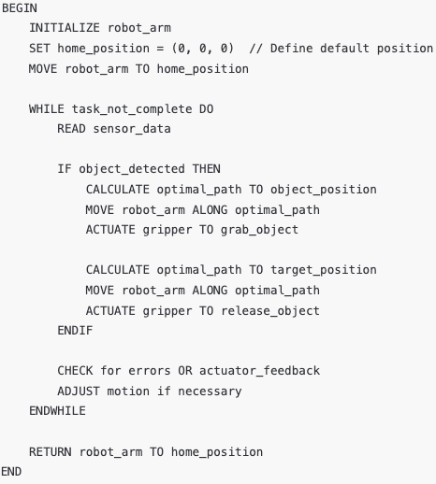
III. Controller Algorithm

Slide 32
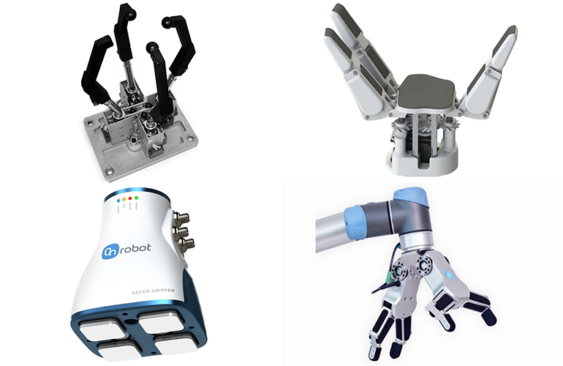
III. Components of a Robot: End Effectors
Definition: the part of the robot that interacts with the environment to perform a task
Examples: grippers, vacuum cups, cutting tools, welding torches
Function: manipulate objects, perform actions such as welding or cutting, or perform sensing tasks
Example: a robot used in a factory may use a gripper as an end effector to pick up and move parts on an assembly line

Slide 33
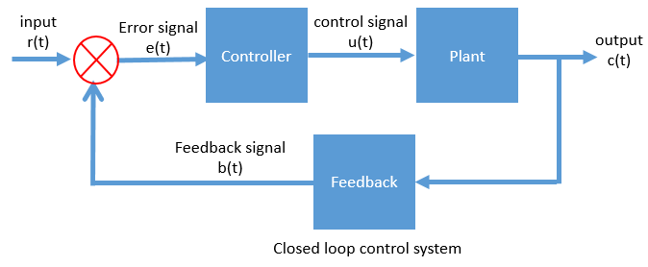
IV. Robot Control
A. Open-loop control: A control system where the control action is independent of the output of the system.
Example: A toaster with a timer. The timer controls how long the toaster heats the bread, regardless of how toasted it actually is.
B. Closed-loop control: A control system where the control action is dependent on the output of the system.
Example: A thermostat controlling the temperature in a room. The thermostat measures the temperature and turns the heating or cooling system on and off to maintain a desired temperature.

Slide 34
Quiz 3

Slide 35
V. Planning to Move: Space
Configuration Space: the set of all possible joint configurations that the robot can achieve.
Workspace: the set of all possible end effector positions and orientations that the robot can achieve.
Configuration space is typically represented using joint angles, joint velocities or joint torques, while workspace coordinates are typically represented using Cartesian coordinates, Euler angles, or quaternions.
The dimensionality of configuration space is equal to the number of degrees of freedom (DOF) of the robot, while the dimensionality of workspace coordinates is typically 3 or 6 for a robot with a fixed end effector.

Slide 36
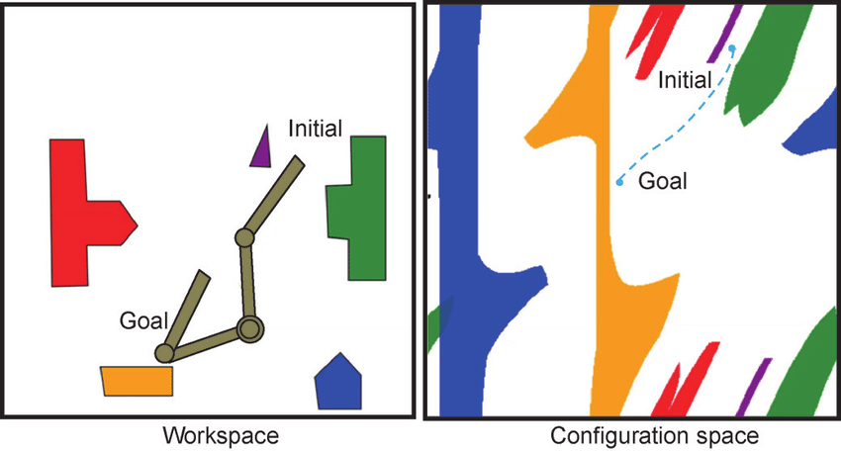
V. Planning to Move: Space
By understanding the relationship between the configuration space and workspace coordinates, we can plan and control the movements of the robot to achieve specific tasks.
The configuration space of 2DOF robot consists of the set of all possible joint angles that the robot can achieve, which in this case is two joint angles, say q1 and q2.
The workspace of the robot consists of the set of all possible positions and orientations of the end effector E. Workspace coordinates can be represented using Cartesian coordinates (x, y) and an orientation angle theta.

Slide 37
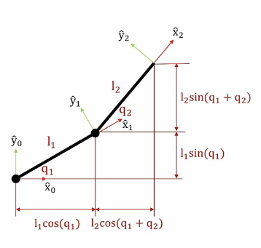
V. Planning to Move: Forward and Inverse Kinematics
Forward Kinematics is the process of determining the position and orientation of the robot's end effector based on the joint angles or other control inputs.
Equation: T = f(q),
where T is the end effector's pose (position and orientation),
f is a function that maps the joint angles q to the end effector's pose
Inverse Kinematics is the process of determining the joint angles or control inputs required to achieve a desired end effector position and orientation
Equation: q = f^-1(T), f^-1 is the inverse function that maps the end effector pose T to the joint angles q.

Slide 38
Quiz 4

Slide 39
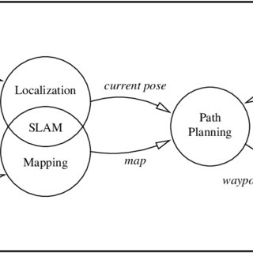
VI. Localization and Mapping
Localization is the process of determining the location and orientation of a robot in an environment, and creating a map of that environment.
Mapping is the process of creating a representation of an environment in the form of a map.
Localization and mapping are interrelated and often performed together in a chain and loop fashion.
The chain starts with mapping, where the robot explores the environment and creates a map.
The map is then used for localization, where the robot determines its location and orientation within the map.
The localization information is then used to improve the map, which is used again for localization, and so on.

Slide 40
VI. Localization
Odometry is the use of sensors to measure the movement of a robot's wheels or joints to estimate its position and orientation.
Equation:
x(t) = x(t-1) + Δs * cos(θ(t-1))
y(t) = y(t-1) + Δs * sin(θ(t-1))
θ(t) = θ(t-1) + Δθ
Function: estimates the robot's position based on the distance it has traveled and the direction it has turned
Example: a mobile robot uses wheel encoders to measure the distance it has traveled and estimate its position and orientation
GPS is the use of Global Positioning System (GPS) signals to determine the location of a robot.
Function: uses signals from GPS satellites to triangulate the robot's position on the Earth's surface
Example: a drone uses GPS to navigate to a specific location and perform aerial surveys.

Slide 41
Quiz 5

Slide 42
VI. Simultaneous Localization and Mapping (SLAM)
SLAM is the process of creating a map of the environment and estimating the robot's position within that map in real time.
SLAM typically involves the use of various sensors, such as cameras, lidar, and IMU, to gather data about the environment and the robot's motion.
The data gathered from the sensors is then processed using algorithms such as Extended Kalman Filter (EKF), Graph SLAM, or Particle Filter, to estimate the robot's position and orientation, as well as to create a map of the environment.
SLAM can be performed using a range of sensor configurations, from simple 2D lidar sensors to complex 3D cameras and depth sensors.
One of the key challenges in SLAM is dealing with sensor noise, as errors in the sensor data can quickly accumulate and lead to inaccurate map and localization estimates.

Slide 43
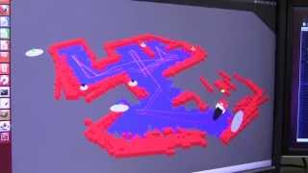
VI. Simultaneous Localization and Mapping (SLAM)

Slide 44
V. Robot Programming
A. Offline programming
Definition: programming a robot without the need for the robot to be physically present
Advantages: reduces downtime, avoids production line interruptions, increases efficiency, and safety
Examples: using computer-aided design (CAD) software to simulate robot movements and generate programs
B. Online programming
Definition: programming a robot while it is physically present and operating
Advantages: allows for real-time adjustments and calibration, and troubleshooting
Examples: teaching a robot new movements and tasks by guiding its arm to the desired positions through a teach pendant or a handheld device

Slide 45
Quiz 6

Slide 46
V. Robot Programming
C. Robot languages
Definition: specialized programming languages designed for robotics
Examples: RoboBasic, RoboLISP, RoboTalk, KAREL, and AML
D. Robot simulation
Definition: creating a virtual environment that models the physical characteristics of a robot and its surroundings to test and verify robot programs before deploying them to the real robot
Advantages: saves time, reduces risks, and avoids costly errors
Examples: software tools such as ROS, RobotStudio, RoboDK, and Webots that enable users to simulate, visualize, and optimize robot movements and tasks.

Slide 47
V. Future in Robotics
Increasing use of AI and machine learning:
AI and machine learning are being used to enable robots to learn from data and make decisions based on it.
Example: Robots that can learn to recognize and sort objects in a warehouse based on their appearance.
Integration of multiple sensors for improved perception and decision-making:
Robotics is moving towards multi-sensory systems to improve perception and decision-making capabilities of robots.
Example: Drones equipped with cameras, GPS, and sensors for collision avoidance.
Development of soft robots for more dexterity and flexibility:
Soft robots are made of flexible and elastic materials and can perform complex movements and tasks that traditional robots cannot.
Example: Octopus-inspired soft robots that can move through narrow and complex spaces.

Slide 48
V. Future in Robotics
Improvement in energy efficiency and power management:
Robotics is becoming more energy-efficient through the use of better power management systems, including energy harvesting and efficient battery management.
Example: Autonomous underwater vehicles that can operate for long periods of time with minimal power consumption.
Use of swarm robotics for collective intelligence:
Swarm robotics involves the use of multiple robots that work together to achieve a common goal.
Example: Swarm of drones that can search an area for missing persons or perform environmental monitoring.
Increasing Human-Robot Interaction (HRI):
HRI involves designing robots that can communicate with humans in a natural way and respond to human input.
Example: Social robots that can interact with humans in a conversational manner and perform tasks.

Slide 49

ROSGPT

Slide 50
Quiz 7

Slide 51
V. Emerging Applications
Use of robots in healthcare for surgery and patient care:
Robot-assisted surgeries for precision and minimal invasion.
Robots to assist elderly patients in their daily activities.
Exoskeletons to aid individuals with mobility impairments.
Development of robotic assistants for elderly and disabled individuals:
Personal care robots for assistance with daily activities.
Companion robots for emotional support and social interaction.
Development of self-driving cars for transportation:
Autonomous vehicles for safer and efficient transportation.
Delivery robots for last-mile logistics.
Use of robots in disaster relief and search and rescue operations:
Unmanned aerial vehicles (UAVs) for disaster assessment and relief.
Robots for hazardous environment search and rescue operations.

Slide 52
V. Impact on Society
Changing the nature of work and employment opportunities:
Increased automation of routine tasks leading to job displacement.
New job opportunities in robotics development, maintenance, and programming.
Example: Robotics automation in automobile manufacturing.
Improved safety and productivity in industries:
Robots replacing human workers in hazardous and dangerous tasks.
Improved accuracy and speed in manufacturing processes.
Example: Welding robots in automotive manufacturing.
Improved quality of life for individuals through robotic assistance:
Personal care robots for elderly or disabled individuals.
Rehabilitation robots for physical therapy.
Example: Mobility exoskeletons for paraplegics.

Slide 53
V. Impact on Society
Increased efficiency in transportation and logistics:
Self-driving cars for safer and efficient transportation.
Delivery drones for faster and cost-effective logistics.
Example: Amazon Prime Air for drone delivery.
Reduction in environmental impact through the use of robotic technologies:
Energy-efficient robots for reducing carbon footprint.
Automated waste management systems for reducing landfill waste.
Example: Robotic garbage collectors in Sweden.
What else???

